Slide 1

Oakland Airbnb Pricing Analysis
TEAM 5 - Evelyn (Wanyi) Dong, Jenny Shang, Qiongqiong Lin, Yoki (Lingrou) Wang

Slide 2
Agenda
1
Introduction & Motivation
2
Data Details
3
Methodology
4
Models & Performance
5
Conclusion

Slide 3
Section 1
Introduction & Motivation

Slide 4


Our Achievements So Far
“ ‘Airbnb’ has become synonymous with one of a kind travel on a global scale.”
$38 Billion
in gross booking value (GBV) in 2019
4 Million+ hosts
+7.4 Million+ listings

Slide 5
Timeline of COVID-19
December 31, 2019
Wuhan Municipal Health Commission first reported a cluster of pneumonia cases of unknown cause.
March 7, 2020
Confirmed number of COVID-19 cases surpass 100,000 globally.
June 28, 2020
Confirmed number of COVID-19 cases surpass 10,000,000 globally.
January 21, 2020
USA reports first confirmed case of novel coronavirus.
April 4, 2020
Confirmed number of COVID-19 cases surpass 1,000,000 globally.
DEC
JAN
FEB
MAR
APR
MAY
JUN
JUL
AUG
February 11, 2020
WHO names the novel coronavirus COVID-19.
May 21, 2020
Confirmed number of COVID-19 cases surpass 5,000,000 globally.
January 9, 2020
Chinese authorities announce pneumonia cases are caused by a novel coronavirus.
March 11, 2020
WHO declares COVID-19 a pandemic.
June 28, 2020
Confirmed death toll from COVID-19 reaches 500,000 worldwide.

Slide 6
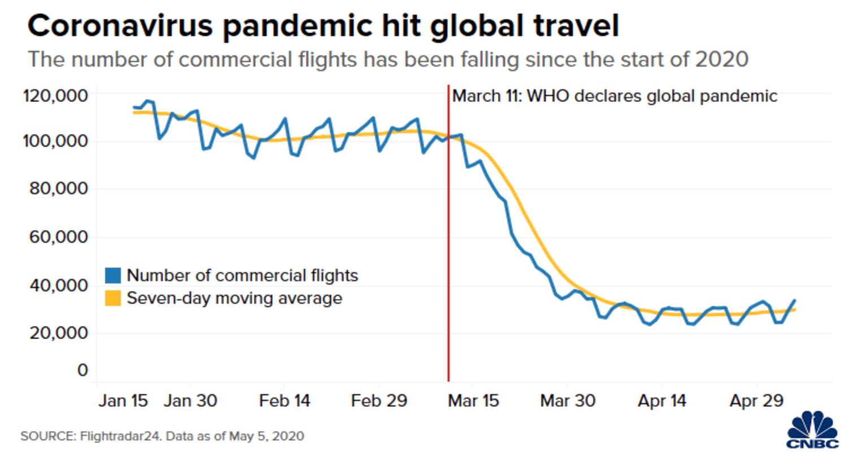
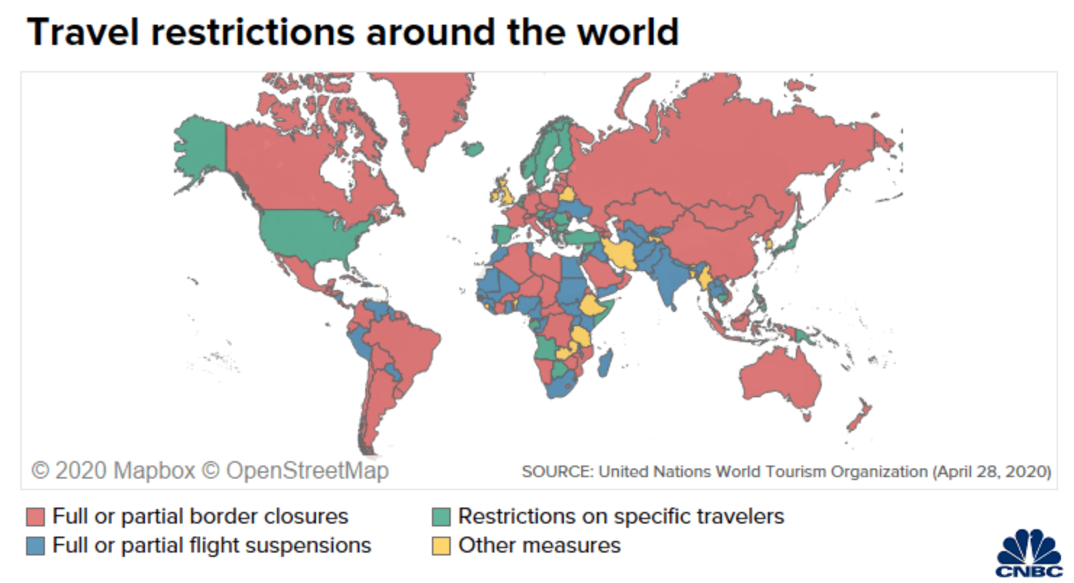
Team Objective
Understand the historical patterns of the Airbnb average listing price
Assess the impact of COVID-19 on Airbnb average listings price using various time-series methods
Generate a 30-day average price forecast
Develop insights and recommendations that can help Airbnb stakeholders in planning and strategy
1
2
3
4

Slide 7
Section 2
Data Details
Notes:
Thanks Jenny. Let me introduce the data we use.

Slide 8
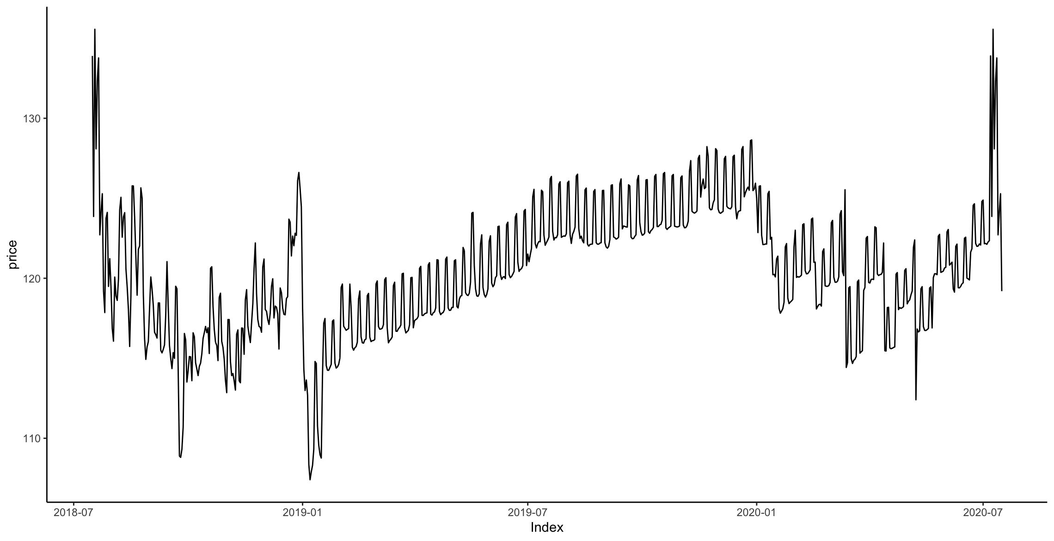
Data Details - Main Data Source
DATA DESCRIPTION
DATASET Inside Airbnb (7/16/2018 - 7/16/2020)
SOURCE http://insideairbnb.com/get-the-data.html
CONTEXT Inside Airbnb is an independent, non-commercial set of tools and data that
allows you to explore how Airbnb is being used in cities around the world.
CONTENT Data frequency is on daily-basis from July 16, 2018 to July 16, 2020 (722 data points).
Cleaned data includes average listing price of all available properties in Oakland, CA.]
Notes:
The raw data we used is obtained from Inside Airbnb, which is an independent, non-commercial and public set of tools that allows you to explore Airbnb data. Data was aggregated to the average listing price of all listings available in the Oakland, CA area, from July 2018 to July 2020, which becomes the data input to build models.

Slide 9



Data Details - External Data Source
We considered three potential alternative data sources :
GDP (Nationwide)
Unemployment
(Nationwide)
Housing Data
(Oakland, CA)
Notes:
In addition, to improve prediction accuracy, monthly data that is publicly available are examined such as GDP, unemployment rate, and housing data in the Oakland area are used in modeling to see if there’s a significant lift to the model.

Slide 10
Section 3
Methodology
Notes:
Now I’ll talk about our methodology.

Slide 11
Data Staging
The year of 2020 has been a disruptive one because of the outbreak of coronavirus, COVID-19.
A test was performed to find the dropping point of the data in 2020, and the date was identified as 1/13/2020. To examine the impact of the pandemic, two functions are designed:
Only using Pre-COVID Data
Data is identified to be data from 8/16/2018 to 1/13/2020
Using all data available
Data is identified to be all data available from 8/16/2018 to 7/16/2020
For two functions, the same analysis method is applied:
A 60 days validation window is reserved to slide and test model performance
Forecast the next 30-day average listing prices as final deliverables
Function 1
Cutoff 1/13
Function 2
Cutoff 5/16
DEC
JAN
FEB
MAR
APR
MAY
JUN
JUL
AUG
2020 Timeline
Change Point
Identified
7/16 Last Data
Point Available
Notes:
We know that the year of 2020 has been disruptive due to the epidemic condition. A test was performed and we found January 13th 2020 to be the changing point. We designed two functions of data staging to assess the impact of COVID-19, which are:
Only including pre-covid data and 2. Using all data available. For both functions, a 60 days validation window is reserved to slide and test model performance. We forecast the next 30-day average listing prices as final deliverables.

Slide 12
Details of Predictive Modeling
6 Methods Were Developed as Candidate Models
Seasonal Naive Forecast (baseline)
Holt Winters Exponential Smoothing
ARIMA
Neural Net
Linear Regression
Decision Tree
Cross-Validation of Prediction Errors
A sliding window for cross validation
Enhance the credibility and reliability of the models
Deployment of
the Predictive Models
Compare patterns of the two staging methods (pre-covid v.s. covid)
Occurrence of the emergency pandemic not aligns with previous historic patterns
1
2
3
Notes:
There are 3 special highlights of our method. First, we tried 6 models total to compare their performance. Secondly, a cross-validation method was adopted by using a sliding window to calculate forecasting errors, which enhanced the model credibility and reliability. Third, the deployment of predictive models aims to compare forecasting differences with two different staging of data. We found that the occurrence of COVID-19 does not align well with previous historic patterns. Now I’ll pass it on to Qiongqiong for detailed comparison of the models.

Slide 13
Section 4
Models & Performance

Slide 14
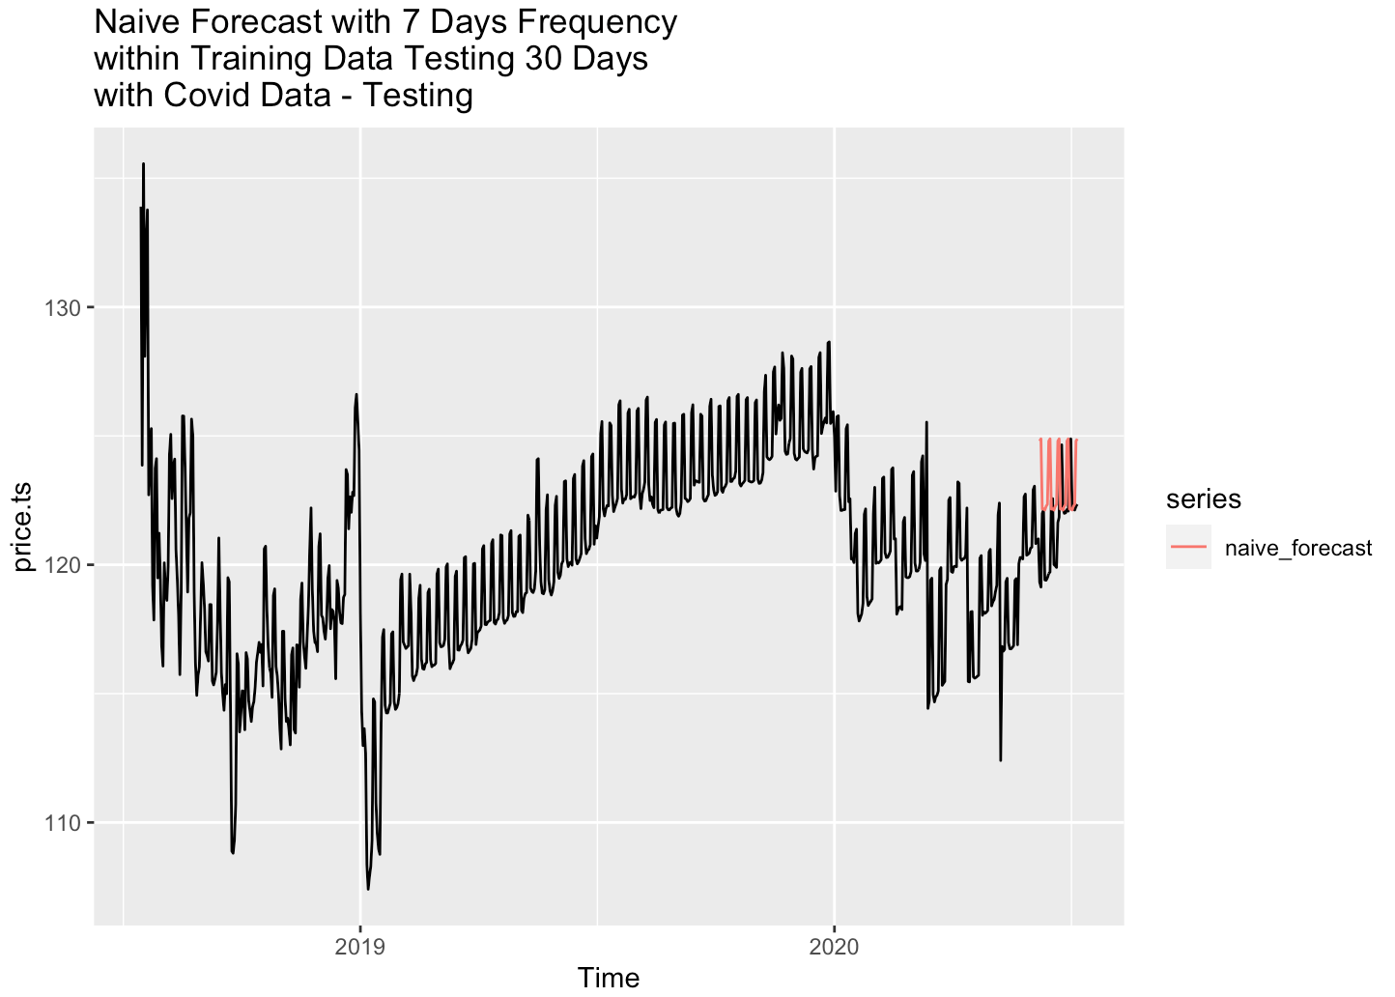
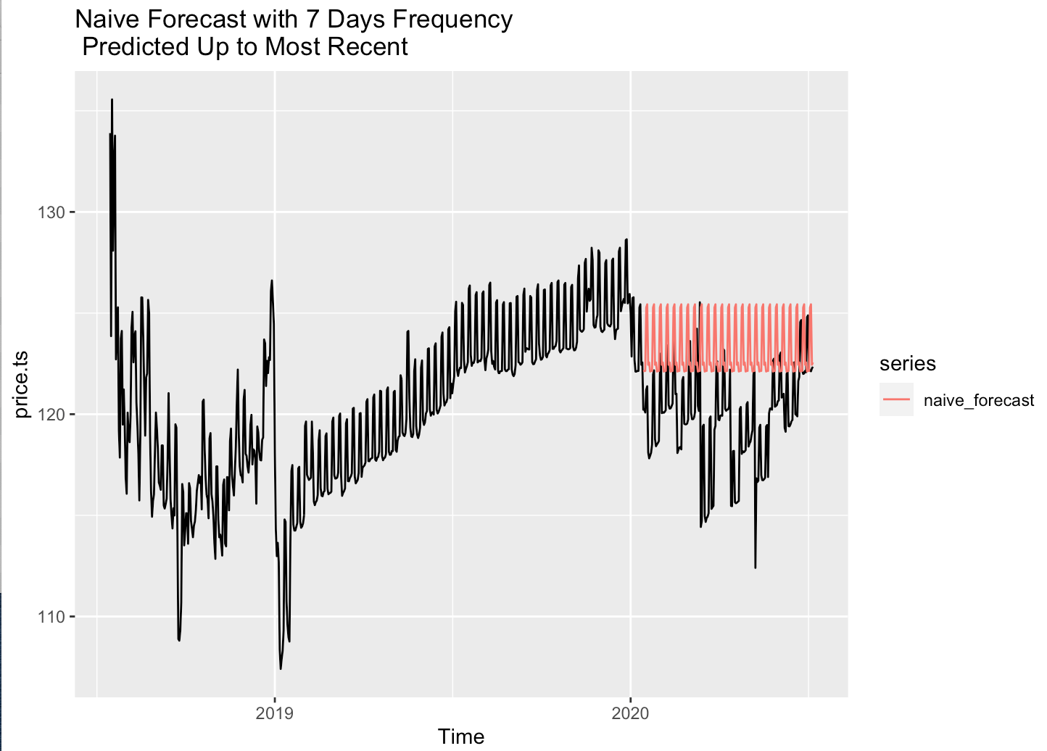
Naive Model (Seasonal)
Naive Model
Uses previous actual data as the prediction of future prices. The rationale behind this method is that the future data will have a similar pattern as historical data. A frequency of 7 is adopted.
Only using Pre-COVID Data
Training MAPE - 1.8, Testing MAPE - 3.03
Using all data available
Training MAPE - 2.26, Testing MAPE - 1..77

Slide 15
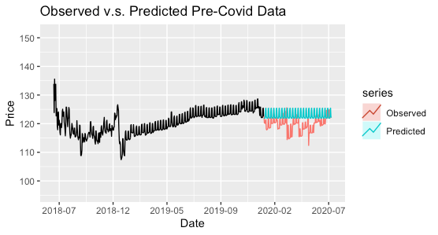
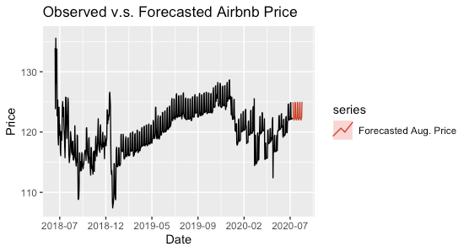
Holt Winters Exponential Smoothing
Holt Winters
The most optimal one with the multiplicative error, a damped-additive trend, and additive seasonality (MAdA). A frequency of 7 is adopted.
Only using Pre-COVID Data
Training MAPE - 0.52, Testing MAPE - 1.52
Using all data available
Training MAPE - 0.68, Testing MAPE - 1.91

Slide 16
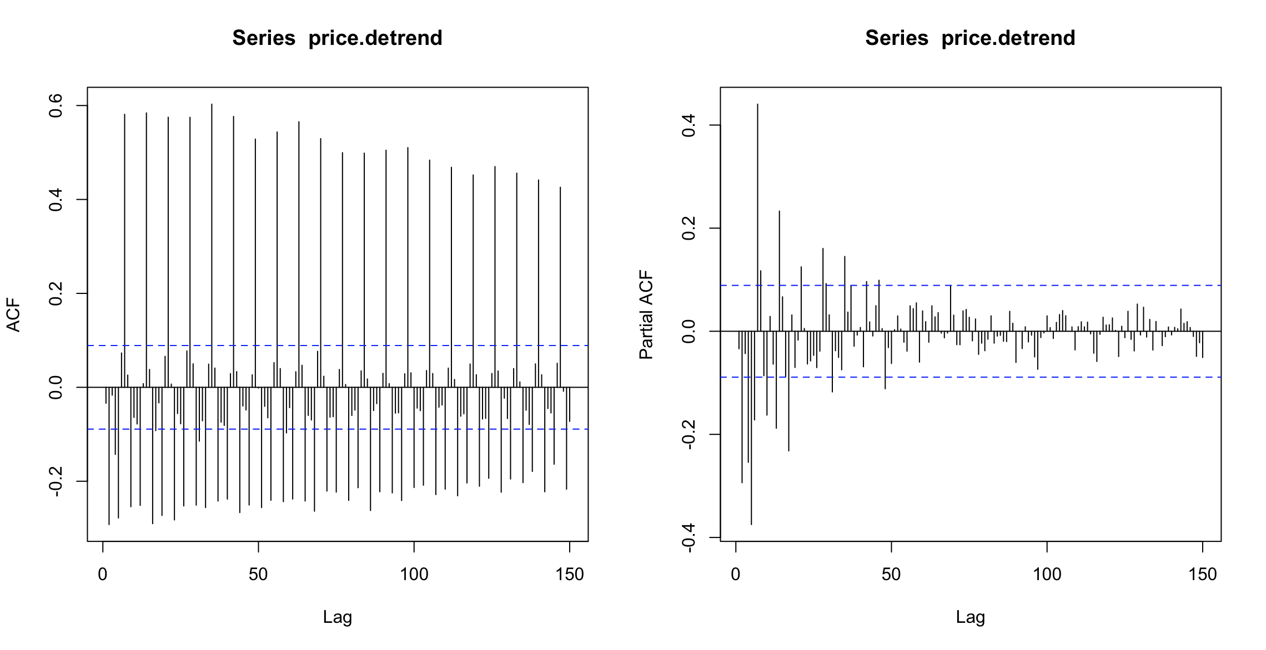
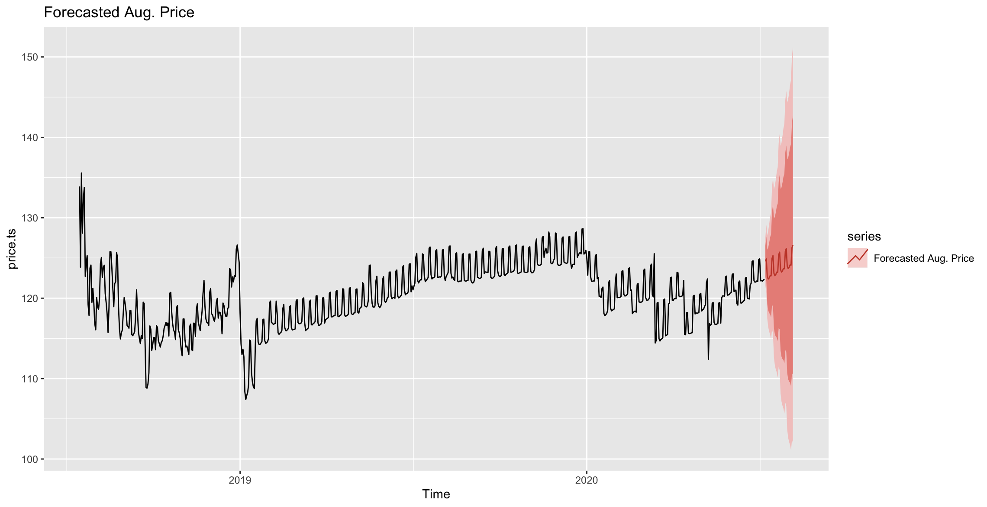
Arima
Arima
The PACF graph cuts off and the ACF graph slowly tails off. According to the ACF and PACF graph, we have tried:
Only using Pre-COVID Data
Training MAPE - 0.54, Testing MAPE - 1.51
SARIMA(0,1,1)(0,1,1)[7]
SARIMA(0,1,0)(1,1,0)[7]
SARIMA(0,1,0)(1,1,1)[7]
SARIMA(1,1,1)(1,1,1)[7]
Using all data available
Training MAPE - 0.62, Testing MAPE - 1.16
SARIMA(0,1,1)(0,1,1)[7]
SARIMA(0,1,0)(1,1,0)[7]
SARIMA(0,1,0)(1,1,1)[7]
SARIMA(1,1,1)(1,1,1)[7]

Slide 17
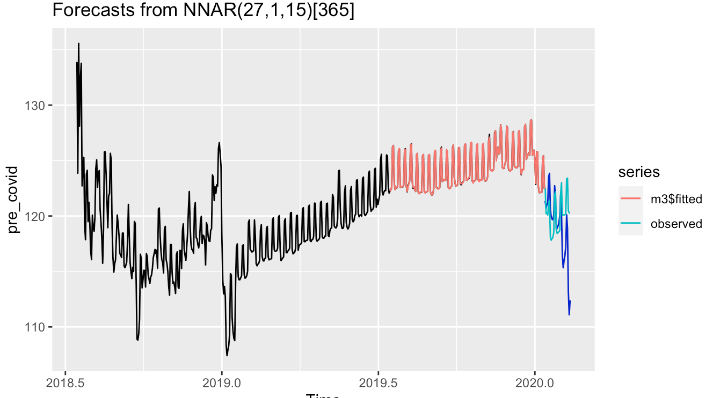
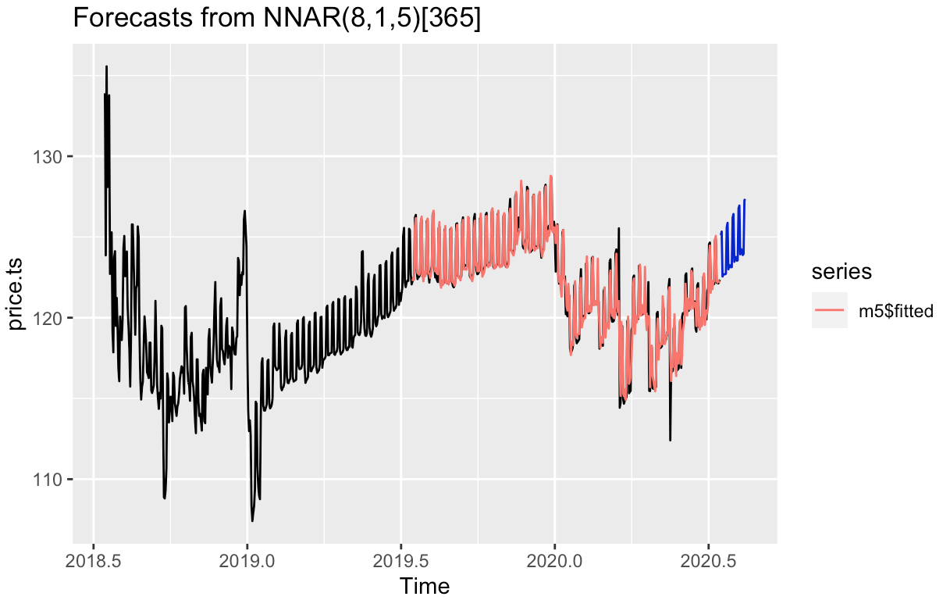
NNAR
NNAR
NNAR is equivalent to an ARIMA model but without stationarity restrictions.
Only using Pre-COVID Data
Training MAPE - 0.1, Testing MAPE - 1.42
NNAR(27,1,14)[365] without external variable
NNAR(27,1,15)[365] with external variable- national GDP
NNAR(27,1,15)[365] with external variable- unemployment rate
NNAR(27,1,16)[365] with GDP and unemployment rate
NNAR(8,1,5)[365]
Using all data available
Training MAPE - 0.3l, Testing MAPE - 4.77
NNAR(28,1,15)[365] without external variable
NNAR(28,1,16)[365] with external variable national GDP
NNAR(28,1,16)[365] with external variablesunemployment rate
NNAR(28,1,16)[365] with GDP and unemployment rate
NNAR(8,1,5)[365]

Slide 18
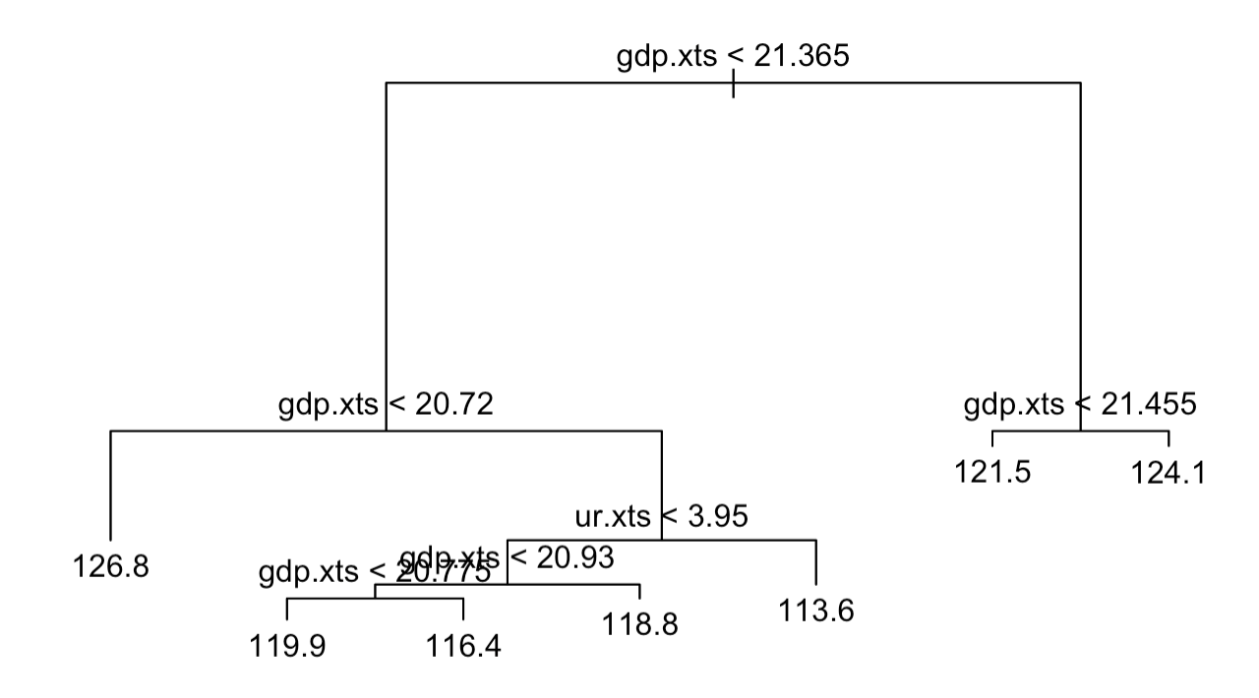
Linear Regression & Decision Tree
Linear Regression
Use external variables (GDP & Unemployment rate) as X to build linear regression model:
Only using Pre-COVID Data Using all data available
MAPE - 2.15 MAPE - 1.97
tslm(price~trend+ur+gdp) tslm(price~trend+ur+gdp)
tslm(price~ur+gdp) slm(price~ur+gdp)
tslm(price~ur) slm(price~ur)
tslm(price~gdp) tslm(price~gdp)
Decision Tree
Decision trees partition all possible values of the attributes into different subcategories or regions and each subcategory is assigned a value. By splitting variables we can predict the Airbnb price through a decision tree model.
Only using Pre-COVID Data Using all data available
Training MAPE - 1.82 Training MAPE - 1.69
Testing MAPE - 2.07 Testing MAPE - 1.78

Slide 19
Section 5
Conclusion

Slide 20




Key Takeaways
Two functions
Assess the impact of COVID-19 pandemic & Predict future values on a 30-day forecasting horizon
Cross-validation to smooth out variability and give a more accurate evaluation
Multiple Methods
Price-only - Naive forecasting, Holt Winters, ARIMA
With external variables (GDP and Unemployment Rate) - NN, Linear Regression, Decision Tree
Best model for Forecasting
SARIMA(0,1,0)(1,1,1)[7]
A robust and accurate result with a training MAPE of 0.61% and a validation MAPE of 1.16%
Scalable, Valuable and Multipurpose
Externally
Collaboration with government
Listers & Travellers
Internally
Executives & Managers
Business Development

Slide 21
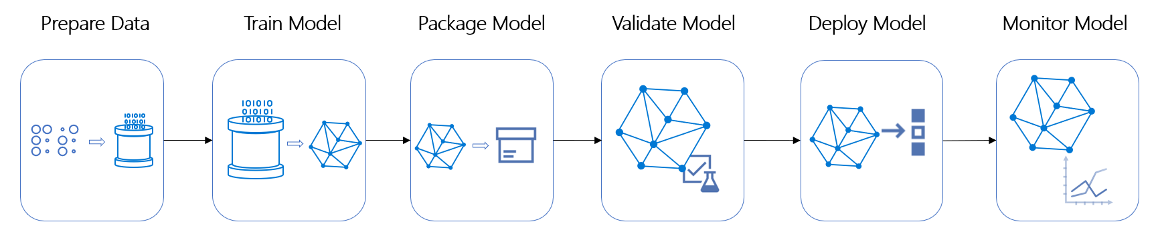
Next Steps
We’re here!
Deploying the forecasting model & Architecturing a pipeline
1
Data storage and retrieval
2
Frameworks and tools
3
Feedback and iteration

Slide 22

Thank You!

